Slide 1



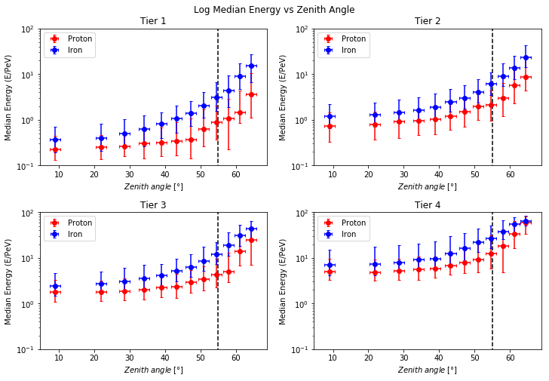
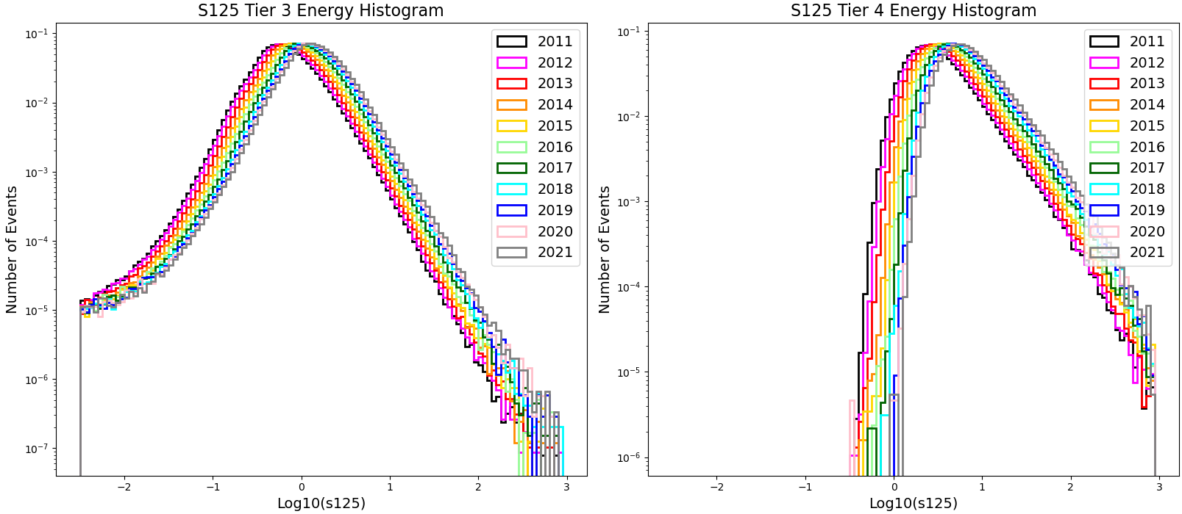
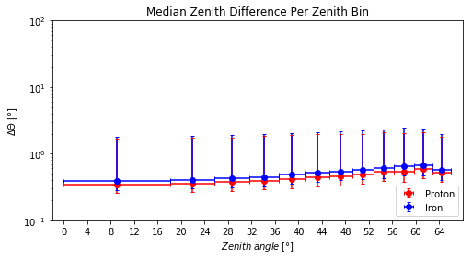
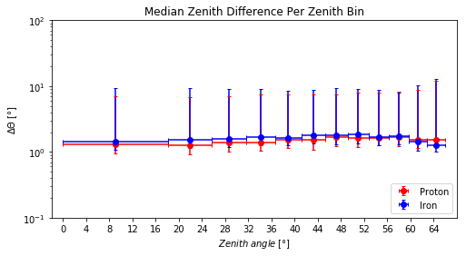
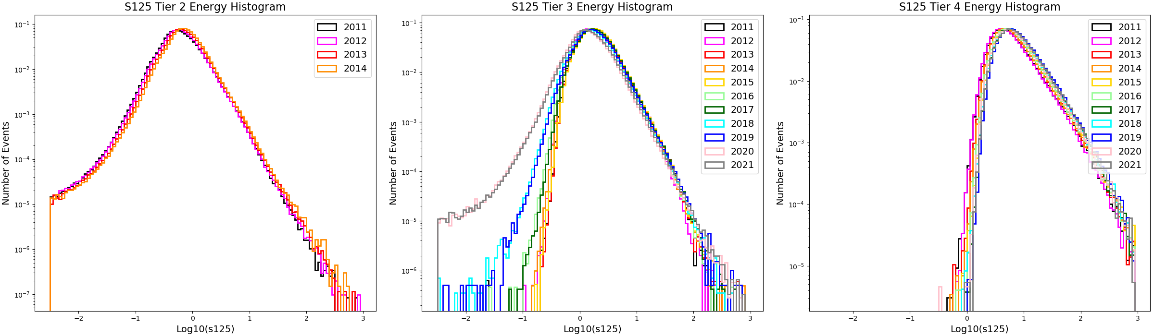
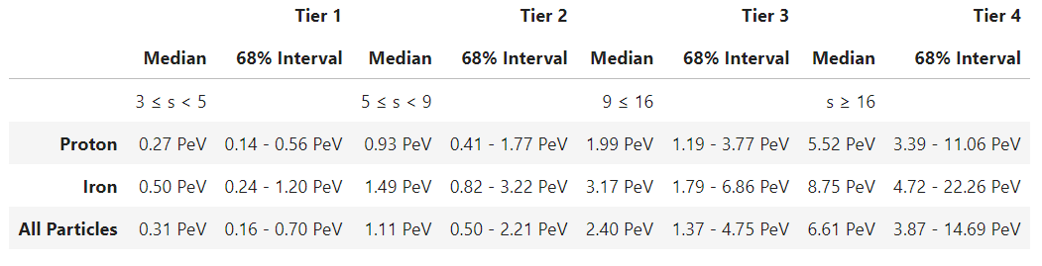
Analyzing Energy Band and Quality Cut Selection for Cosmic Ray Anisotropy Studies
S. Lehrman^{(a)}, G. Agrawal^{(a)}, G. Bratrud^{(a)} , J. Summers^{(a)}, R. Abbasi^{(a)}, F. McNally^{(b)}, P. Desiati^{(c)}, J. Díaz-Vélez^{(c)}
^{(a)}Loyola University Chicago, ^{(b)}Mercer University​, ^{(c)}University of Wisconsin-Madison​
For the IceCube Collaboration
Background
The goal of this analysis is to study the energy dependence of the cosmic ray anisotropy using IceTop data. The IceTop detector is located at the South Pole on the surface of the IceCube detector. IceTop is made up of 81 stations that can detect cosmic ray events. Since IceTop cannot directly detect the energy of an event, the number of stations triggered is a proxy for the energy of the event. To study the energy dependence, we divided the data into four energy bands. Energy band 1 corresponds with the lowest energy events, and the energy increases with the band number. These bands are divided by the number of stations triggered.
Simulation Study
A Monte Carlo Simulation based on the 2012 run year was used to determine the quality cuts necessary for our analysis and to find the median energy of our four energy bands. Since the detector layout is consistent for all 11 years of our analysis, we only need to use the 2012 simulation. From the simulation, we determined that we should exclude data above 55° zenith (Fig. 2). The simulation also showed that our angular resolution is sufficient without need for additional cuts (Fig. 3).
Snow Accumulation
The detector’s location on the surface in the South Pole means that snow can affect the data. Snow accumulating on the detector can prevent some lower energy events from triggering the minimum number of stations needed to register an event. Additionally, with more snow, a high energy event may trigger less stations. Over time, the energy of events detected by IceTop is artificially increased. Since the scope of our study is 11 years, we must understand the effect that the snow has on our data.
To see how the snow affects our data, we plotted histograms of an energy estimator, the s125 parameter, for each run year. We created these histograms for our four energy bands. The initial histograms were created with the station boundaries of the energy bands consistent throughout all 11 years. These histograms showed how the energy was shifting upwards over time (Fig. 1). To address this, we adjusted the station cuts each year so that the histograms would align. We found that increasing the boundaries of the energy bands by one station every two years compensated for the snow accumulation effect (Fig 1).
Old Station Cuts
Figure 2: Graphs of the median energy versus zenith angle using the MC simulation data.
New Station Cuts
Figure 3: Zenith difference between simulation and reconstruction versus zenith angle for proton and iron for tier2,3,4 (left) and Tier1 (right).
The 2012 Monte Carlo simulation was also used to determine the median energy of our four energy bands (Fig. 4). The station cuts used are the 2012 station cuts determined from our snow accumulation analysis.
Figure 1: On the top is the Log₁₀(s125) histograms with consistent cuts applied to all 11 years of data. On the bottom is the Log₁₀(s125) histograms with the new station cuts applied to account for the snow accumulation effect. On the left of the histograms are the corresponding medians.
Figure 4: This is a table with the median energies of the four energy bands determined by the Monte Carlo simulation.
Summary and Future Outlook:
These station cuts and quality cuts have been used to create 2D skymaps and 1D projections. However, the maps and projections were made using only a 10% burnsample data to ensure that we are not introducing bias to our analysis. Our next steps would be to apply these station cuts and quality cuts to the whole data set and complete the unblinded analysis.

