Slide 1
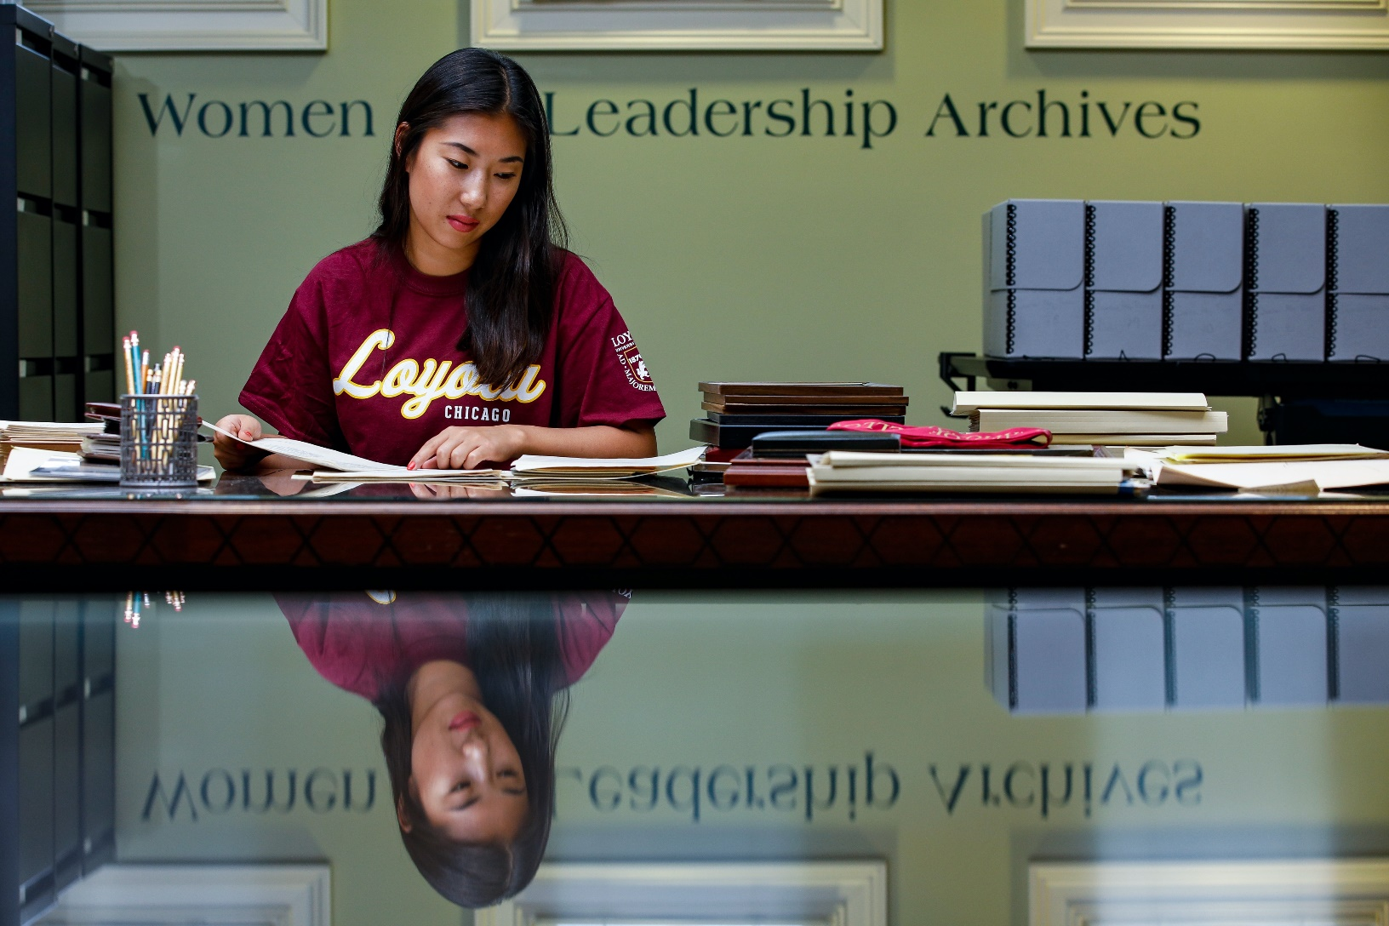
Women & Leadership Archives

Slide 2
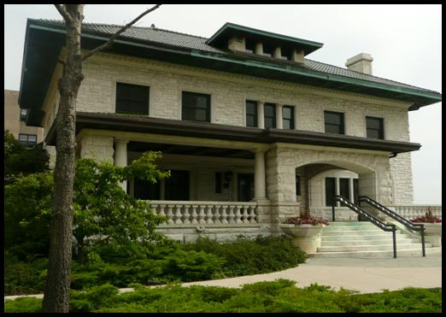
Our Home in Piper Hall
Established in 1994
Beginnings with Mundelein College
Piper Hall – Once Mundelein College Library
Gannon Center and University Libraries

Slide 3
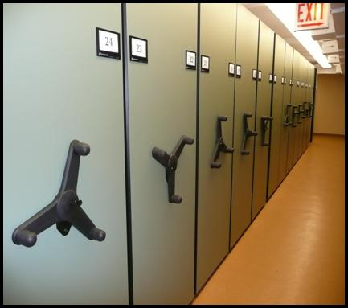
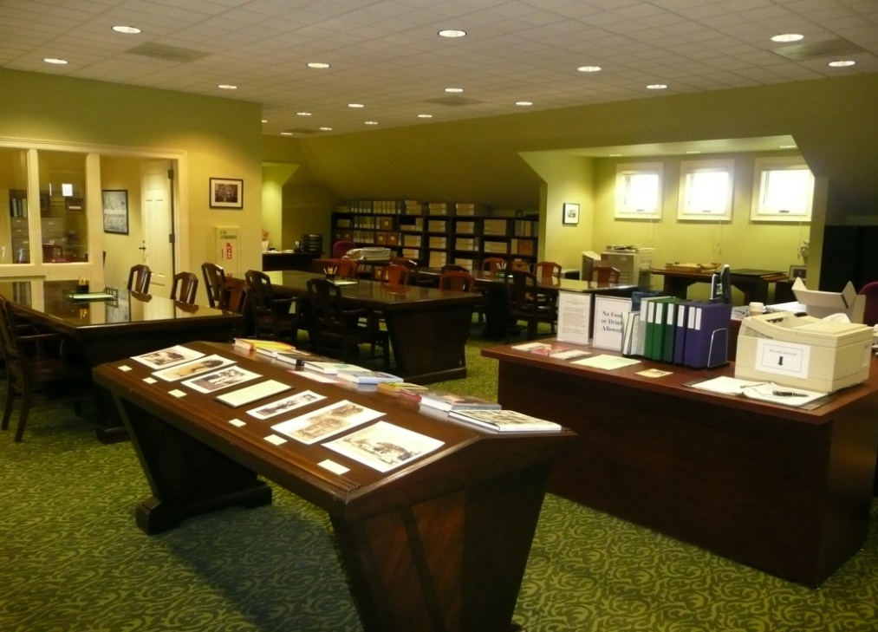
Collecting Scope and Access
Collect and make available permanently valuable records of women and women’s organizations, which document women’s lives, roles, and contributions.

Slide 4
Collecting Subject Areas
Activism and Women’s Issues
Athletics
Civic and Cultural Engagement
Education
Environment
Mundelein College
Public Service and Politics
Science, Technology, and Engineering
Social Justice
Visual, Performing, and Fine Arts
Women Religious

Slide 5
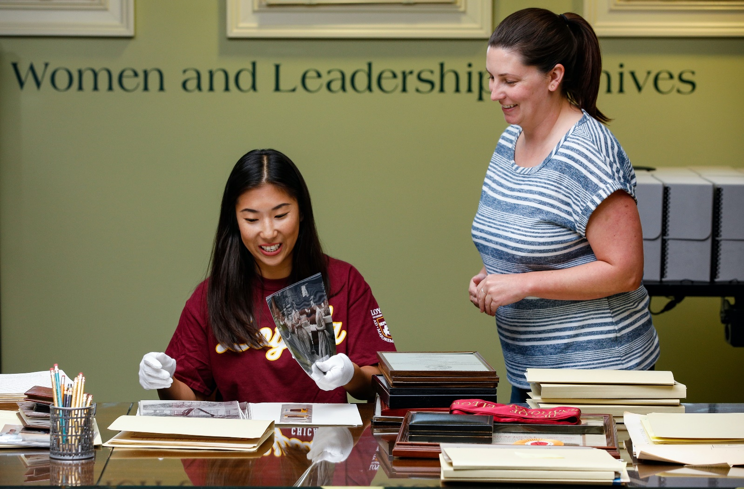
Our Researchers
Serve a wide variety of users ranging from students and scholars to the general public

Slide 6
Visiting the WLA
By appointment for the Fall semester

Slide 7
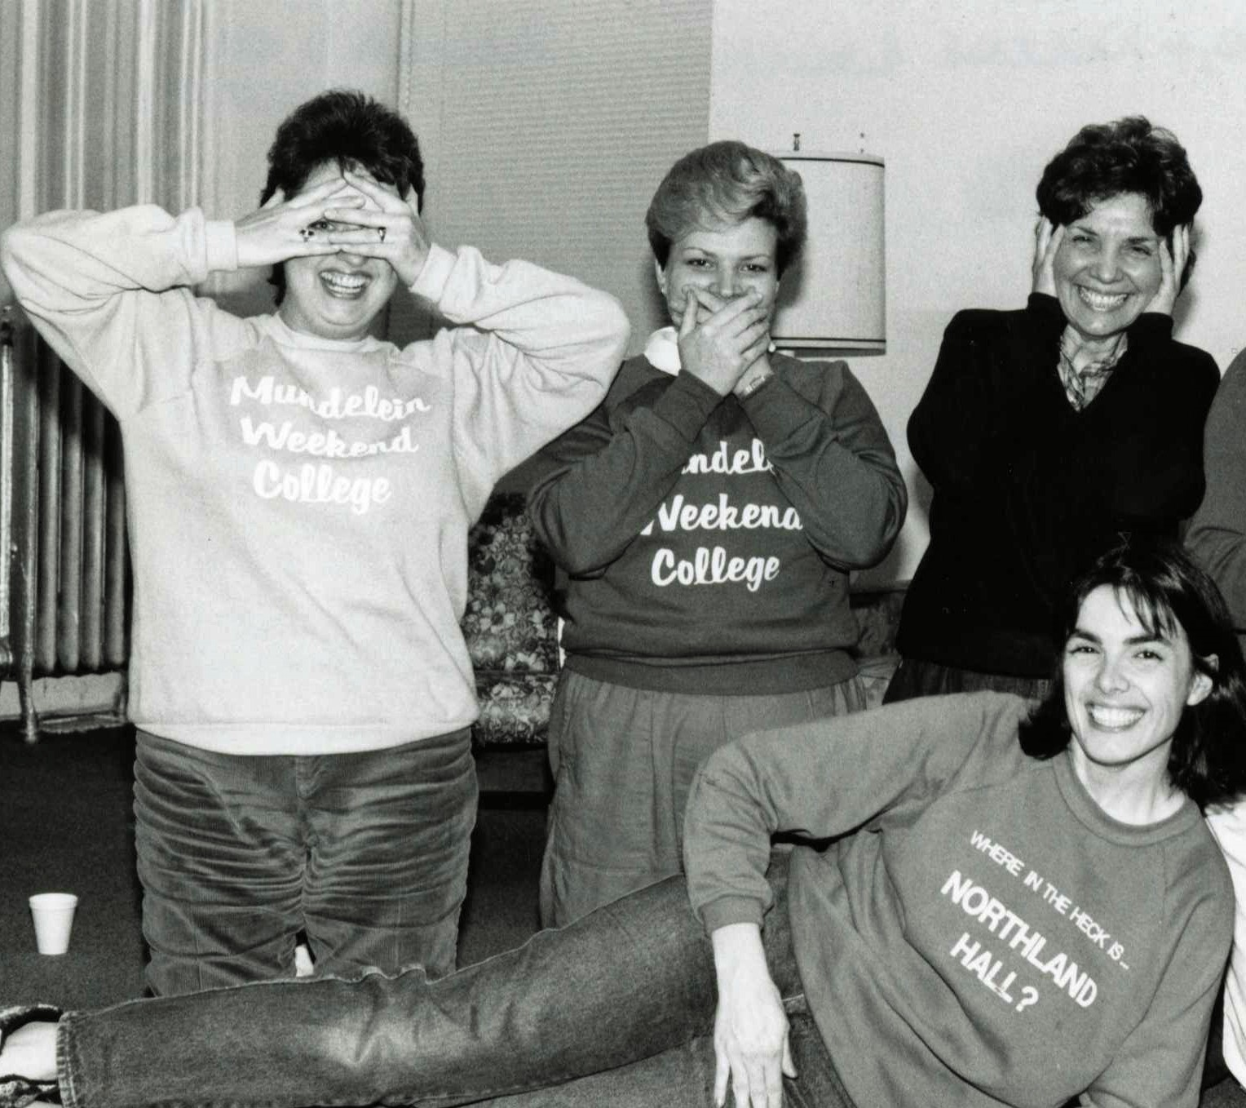
Digital Mundelein Collections
The Skyscraper Newspaper
Class Photos
Yearbooks
Photographs
Founding and early years

Slide 8
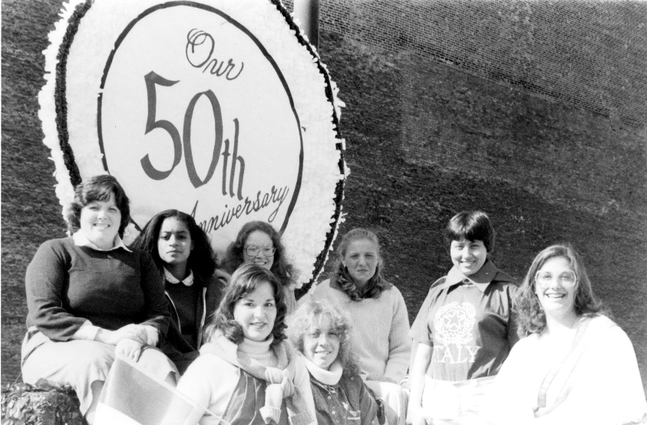
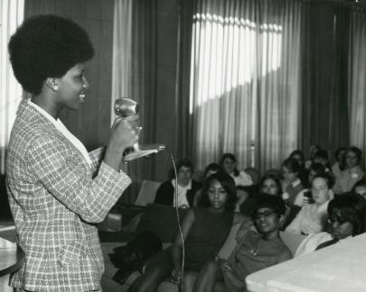
Mundelein Digital Exhibits
Share Your Story: Student Life at Mundelein
Activist Mundelein: Civic Engagement at a 20th Century Women’s College

Slide 9
Recent Mundelein Projects
Class of 1971 Exhibit
Mundelein College 90th
Updated Mundelein Timeline
WLA YouTube: Vespers Video

Slide 10
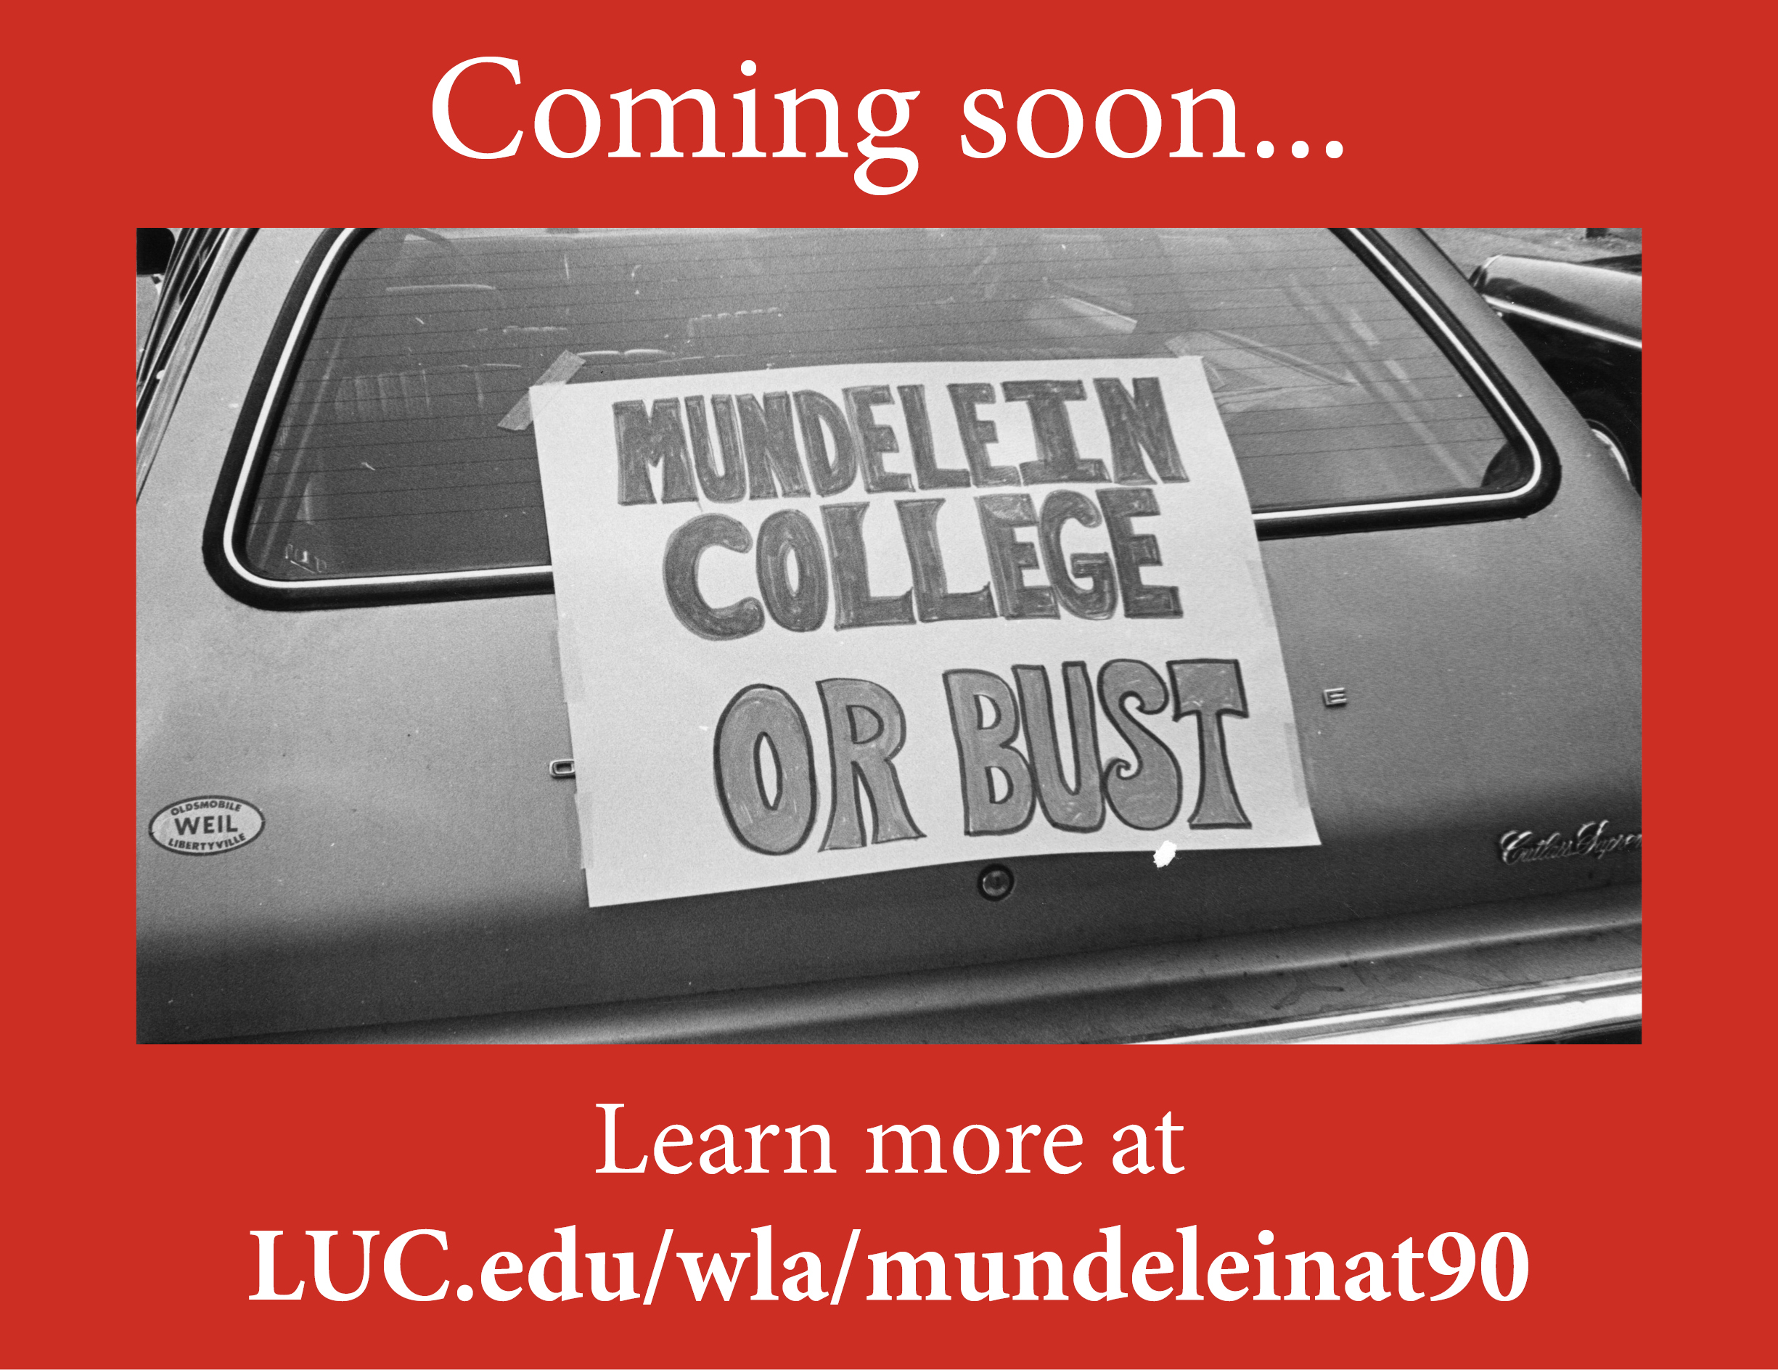

Slide 11
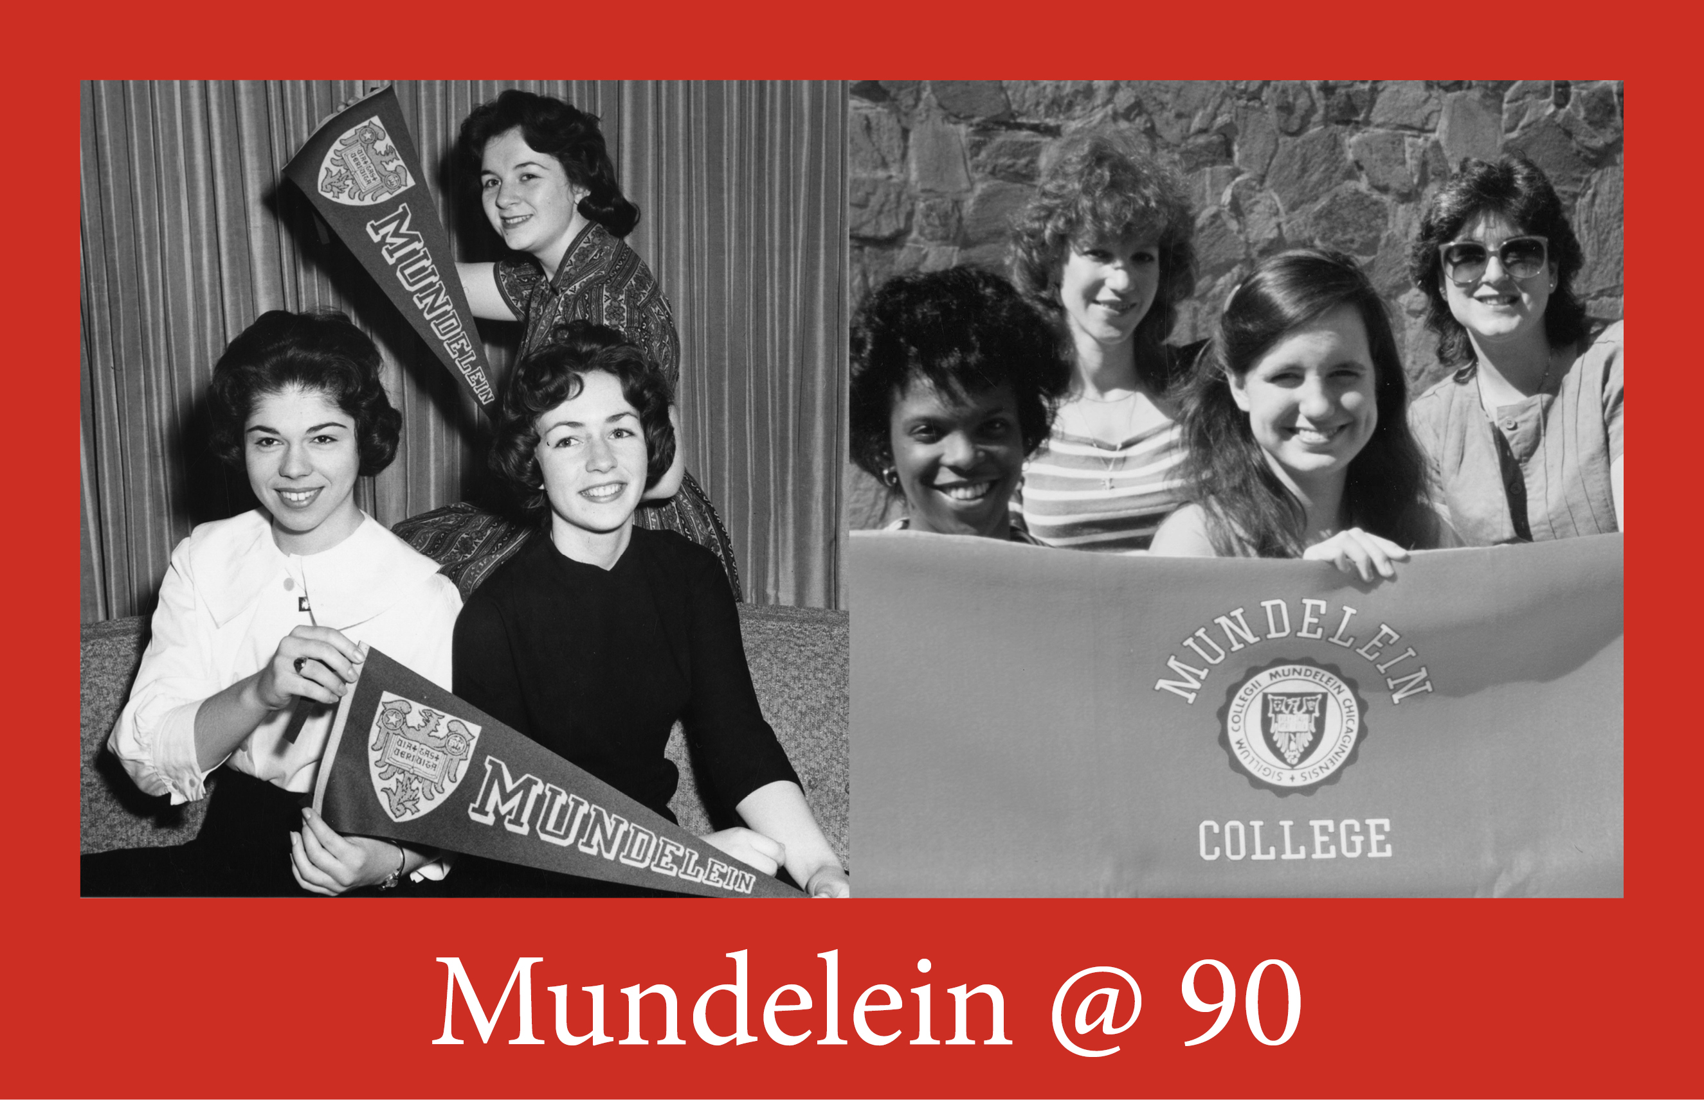
Notes:
Illinois History Digital Imaging Grant, Illinois State Library
2021- summer 2023
The Mundelein College at 90 Digitization Project aims to digitize and provide online access through the Illinois Digital Archives to unique historical records previously only available in person at the Women and Leadership Archives.
$84k – primarily used to fund additional student workers; small portion on these funds used for outside digitization services
Thanks to Illinois Secretary of State and State Librarian Jesse White

Slide 12
Questions?
Emily Reiher, CA
WLA Director ereiher@luc.edu
WLArchives@luc.edu
LUC.edu/wla facebook.com/WLArchives/

