Slide 1
Engagement and Intellectual Curiosity: Pedagogy that Encourages Student Participation in Disciplinary Work
Loyola University of Chicago
January 12, 2012
Joan K. Lippincott
Coalition for Networked Information

Slide 2
Coalition for Networked Information (CNI)
Joint program of Association of Research Libraries and EDUCAUSE, bridging library/IT interests in use of scholarly information in the Internet environment
Teaching and learning
  New learning collaborations (began 1994)
  Convergence of literacies – information/IT/media
  Learning spaces – formal and informal
www.cni.org

Slide 3
Talking about learning
National policy emphasis:
My emphasis today:
Success
Completion
Retention
Students as clients/products
Engagement
Curiosity
Creation of new academic content in the context of learning
Students as learners

Slide 4
Student engagement in learning
Learning that is:
  Active
  Social / Collaborative
  Building on a framework of disciplinary knowledge
  Public and shareable

Slide 5
Thinking about what matters
“Intellectual curiosity is a strong predictor of future academic success…That conclusion was based on a meta-analysis of 200 previous studies…”
CHE 10/27/11 citing study in Perspectives on Psychological Science
How can we inspire curiosity?

Slide 6
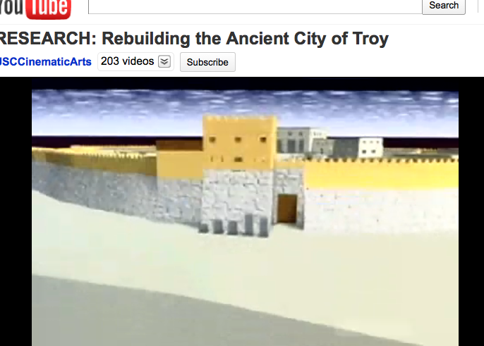
My inspiration: Undergrads create 3-D fly-through of the City of Troy
http://www.youtube.com/watch?v=E0qOzjT2BSY

Slide 7
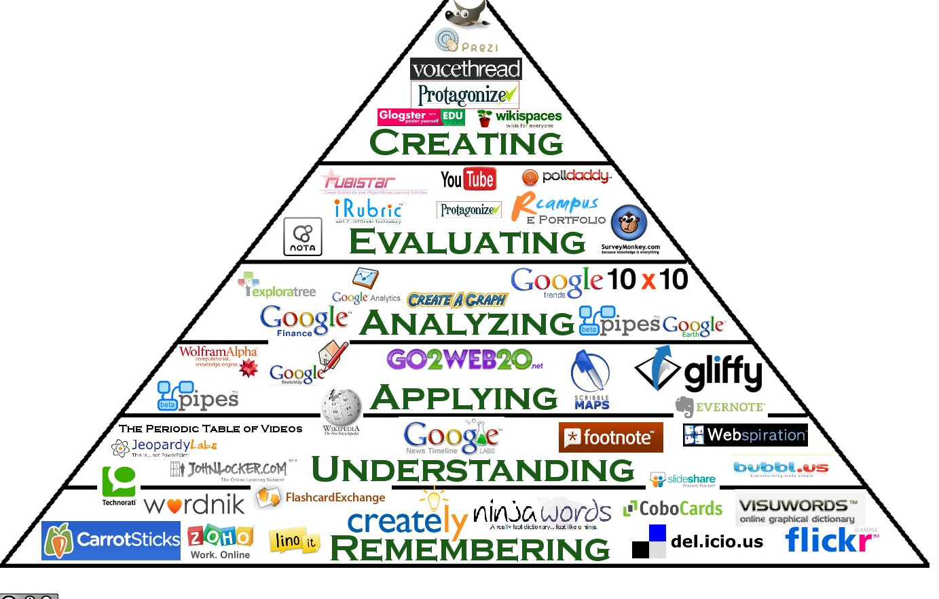
This work is licensed under a Creative Commons Attribution-NoDerivs 3.0 Unported License.
Author: Samantha Penney, samantha.penney@gmail.com

Slide 8
Students can
Actively participate in learning, building on course content
Collaborate with others to create new digital content that they can share
Analyze a wide variety of information resources as background and content for their projects

Slide 9
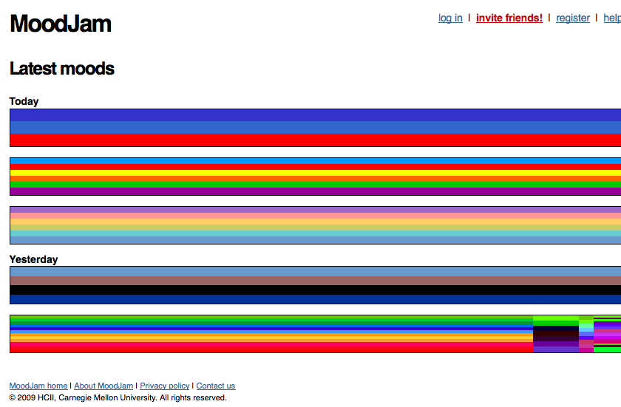
Today’s students: creative and visual learners
http://www.moodjam.org/

Slide 10
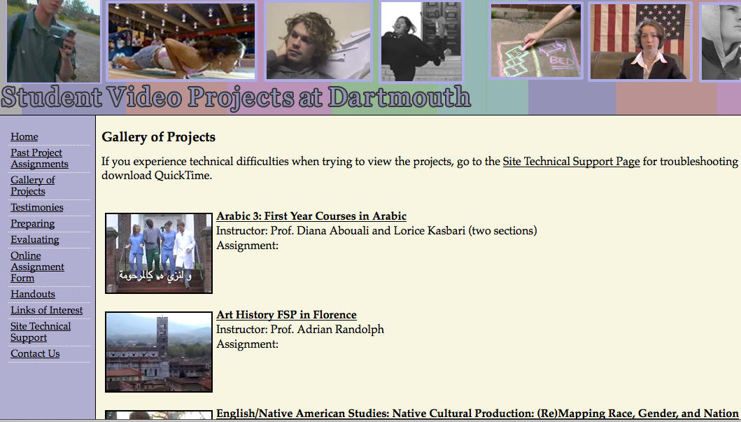
Today’s students: knowledge seekers and creators
http://www.dartmouth.edu/~videoprojects/gallery.html

Slide 11
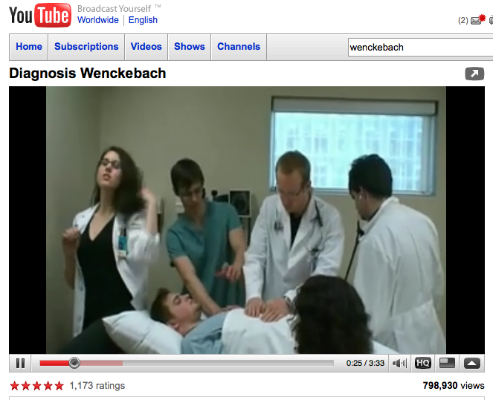
Today’s students: blend academic and social lives
A spoof of Justin Timberlake's "Sexyback" done by the University of Alberta 2010 Med class.
Wenckebach is a type of cardiac arrhythmia. http://www.youtube.com/watch?v=GVxJJ2DBPiQ

Slide 12
We need better strategies to
Move students into higher order thinking
Provide opportunities for students to be practitioners of their discipline
Develop assignments that assist students in representing scholarly information in new forms

Slide 13
We need to assess our students’ tech/info/media literacy skills
47% of students say that only some or almost none of their instructors provide adequate training for the IT used in the course
47% of students agreed or strongly agreed that by the time they graduate, the IT they have used in courses will have adequately prepared them for the workplace; an additional 38% were neutral
ECAR Study of Undergraduate Students and Information Technology, 2010 educause.edu/ecar

Slide 14
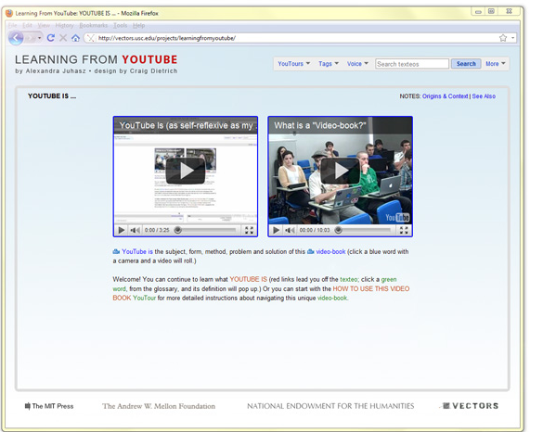
Undergrads work with faculty on research
The first video-book published by MIT Press
Students studied YouTube
“Helps us think of new forms of practice…[by experimenting with] academic publishing itself” F. Ginsburg, NYU
http://mitpress.mit.edu/catalog/item/default.asp?ttype=2&tid=12596

Slide 15
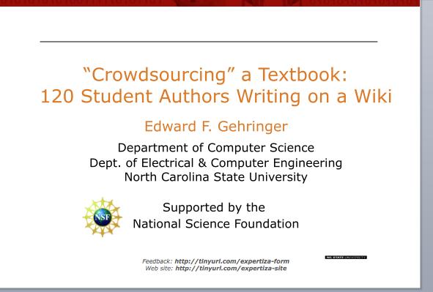
Students co-author textbooks
Architecture of Parallel Computers and Object-Oriented Design courses
Students took ownership of their learning
Contributions were peer-reviewed
http://www.educause.edu/Resources/CrowdsourcingaTextbook120Stude/223704

Slide 16
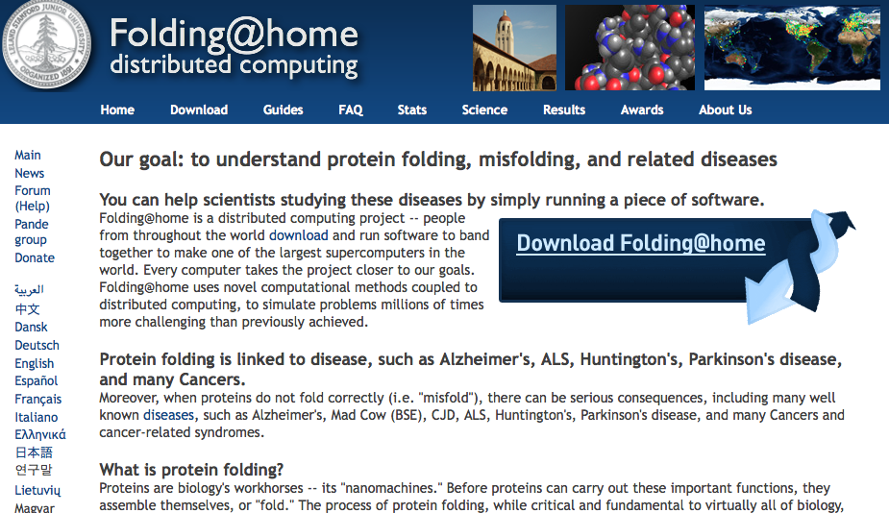
Students participate in authentic science
http://folding.stanford.edu/

Slide 17
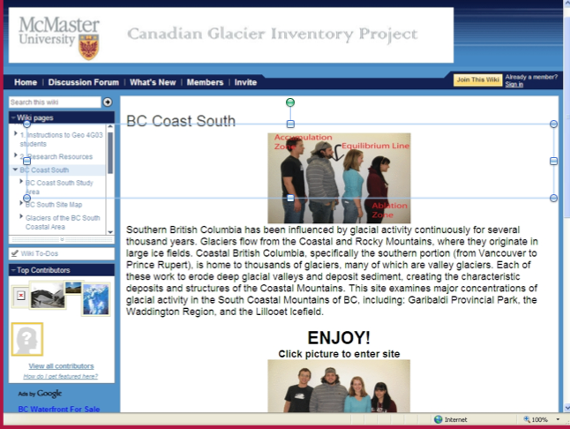
Students contribute to a national project in geography and earth sciences
http://cgip.wetpaint.com/

Slide 18
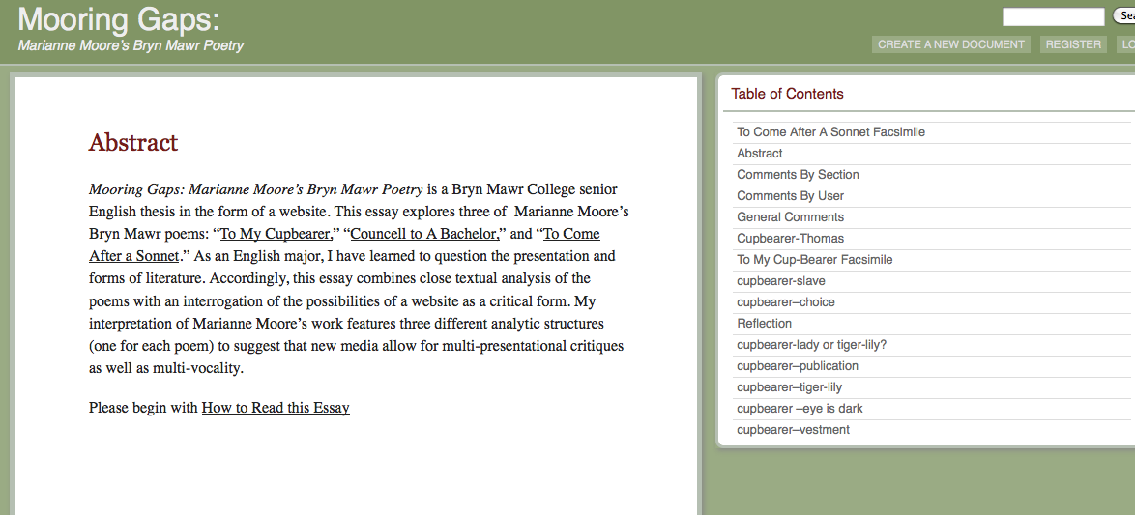
Students create new types of capstone projects
http://mooreandpoetry.blogs.brynmawr.edu/abstract/

Slide 19
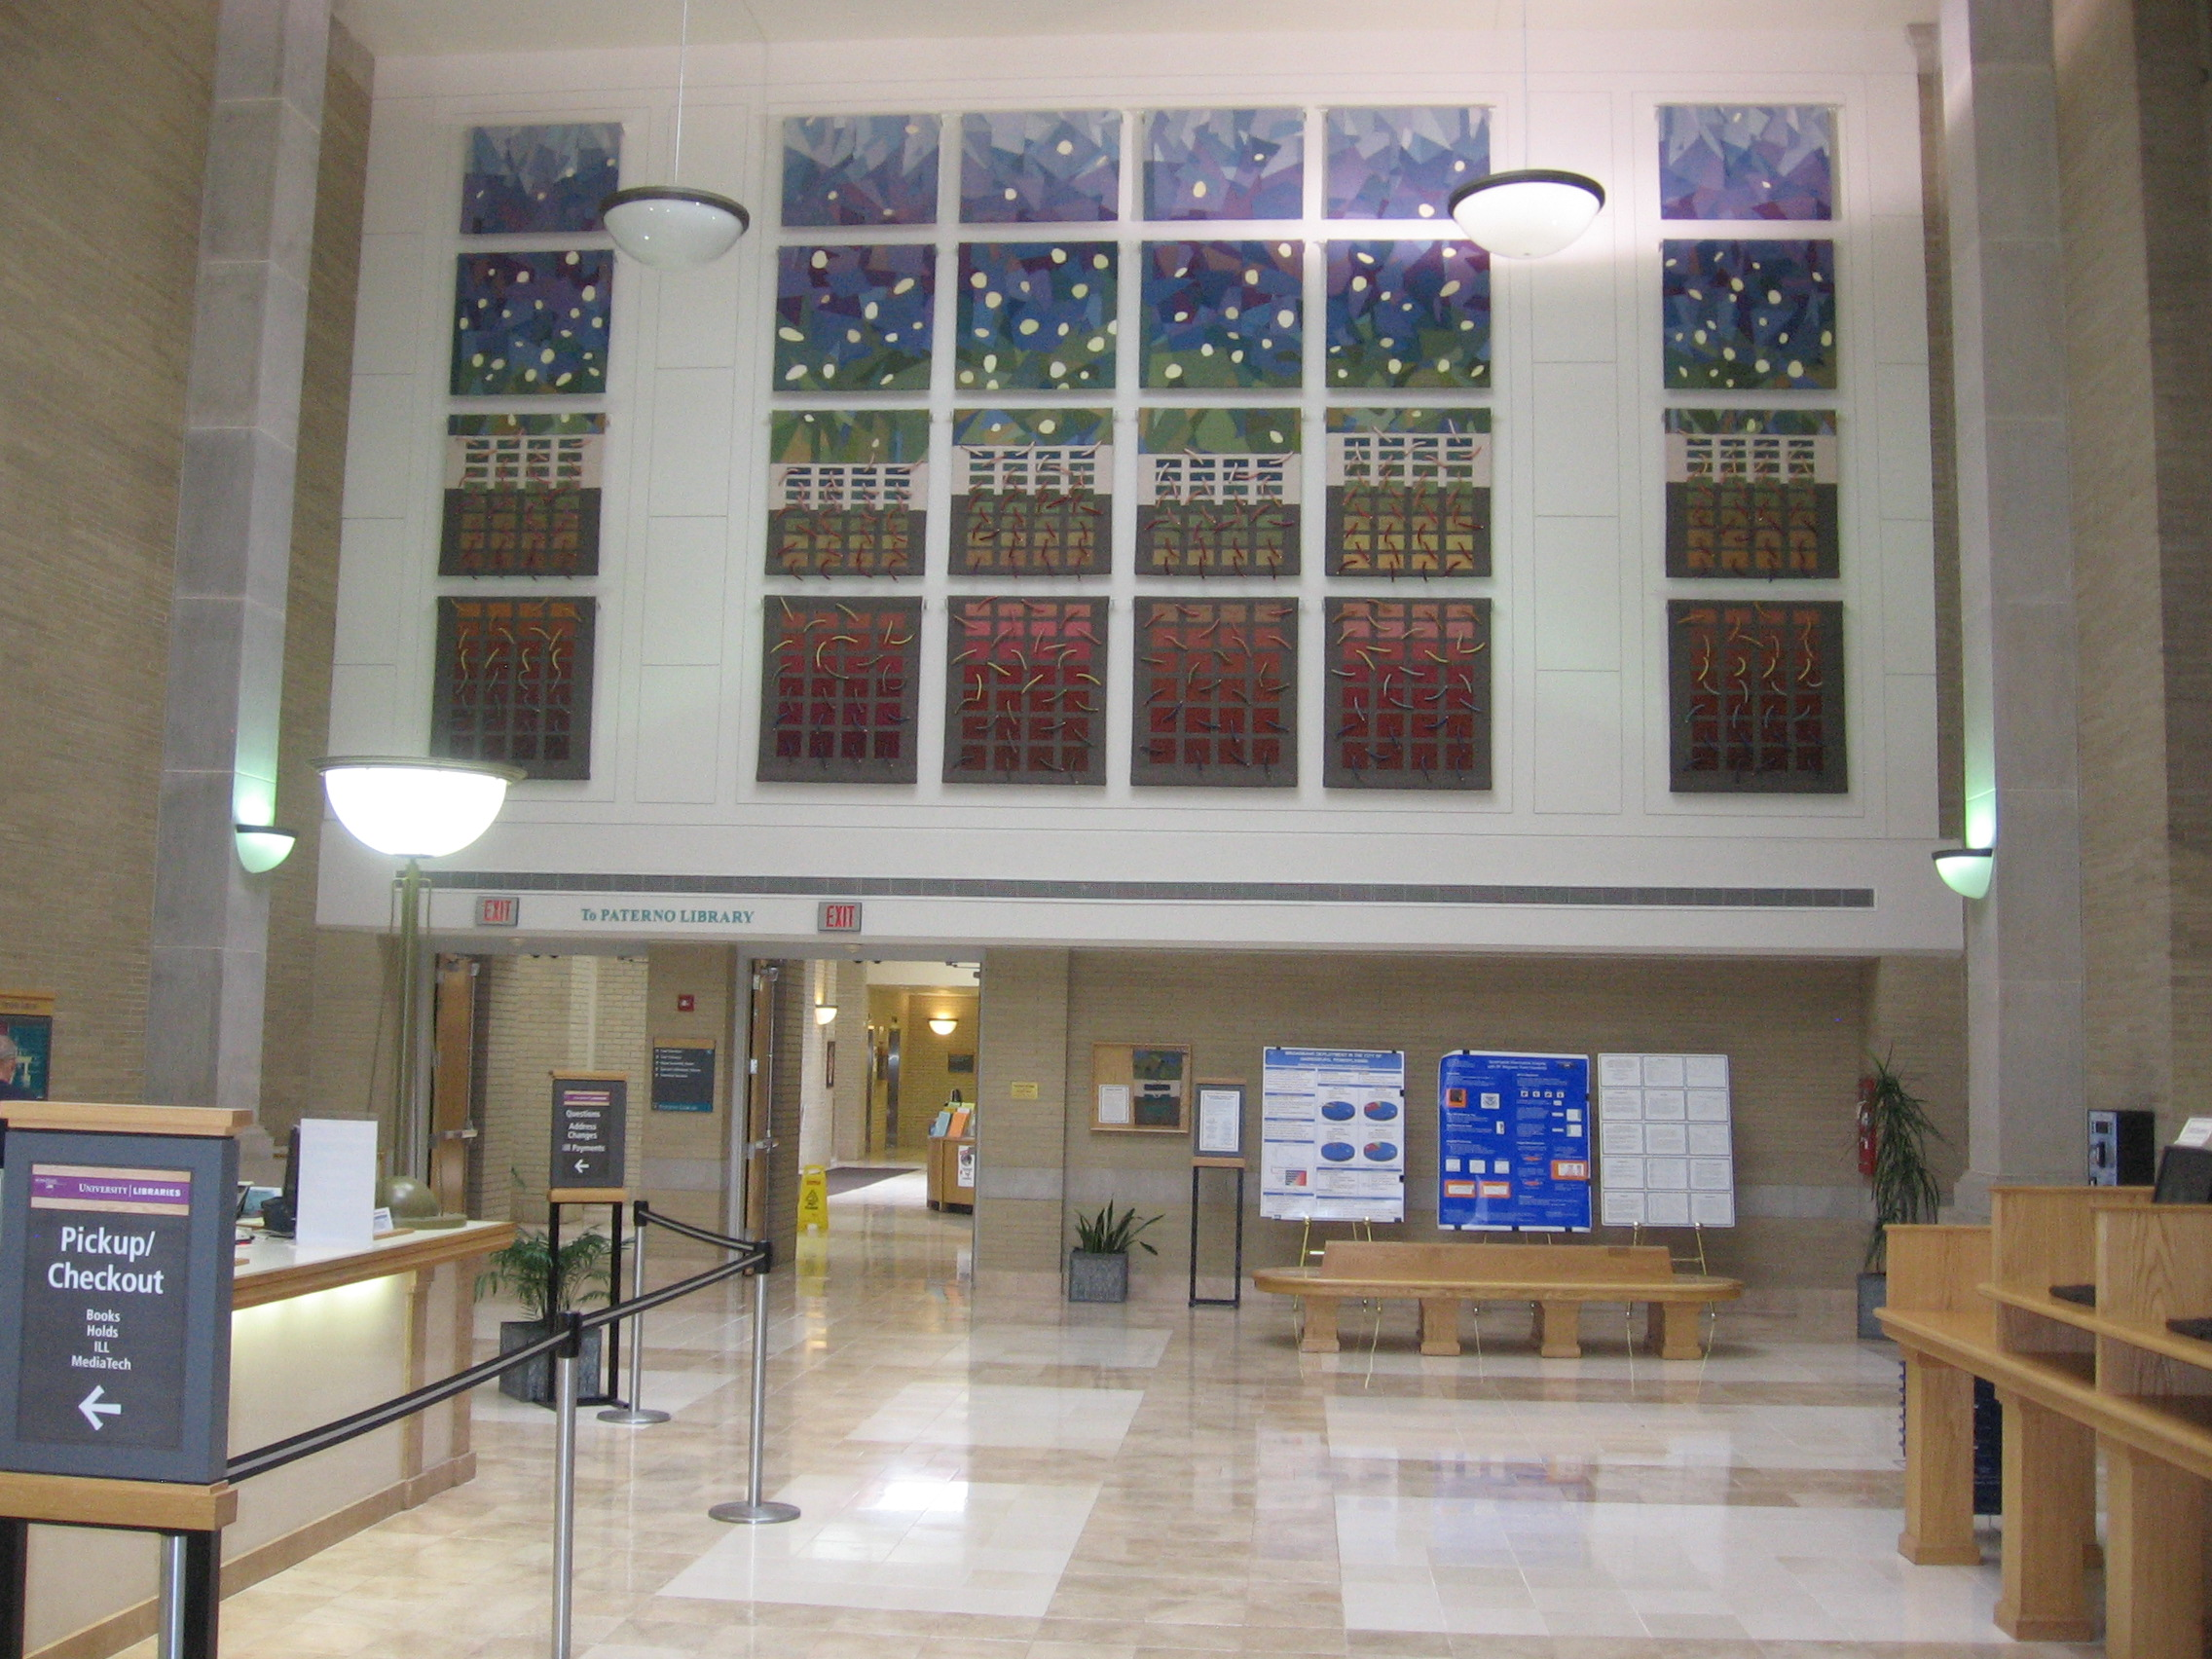
Students exhibit their undergrad research posters at Penn State library

Slide 20
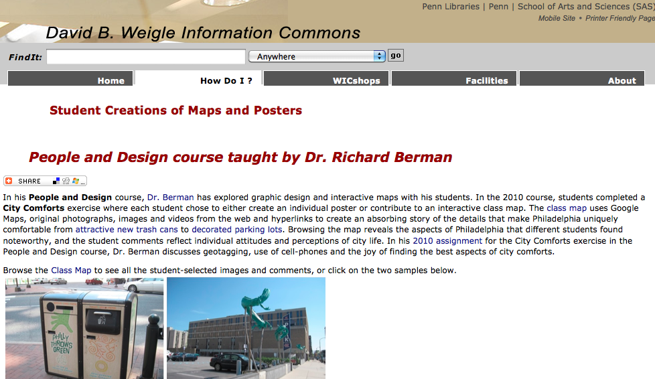
UPenn students develop interactive maps and posters for the local community
http://wic.library.upenn.edu/wicideas/success.html

Slide 21
Faculty can work with the Center for Pedagogy, information professionals, instructional designers, and technologists to:
Develop new kinds of course projects
Assist students in developing strategies to find content
Ensure that students have the opportunity to learn skills and have access to follow-up assistance
Emphasize need to develop an academic argument
Build in conversations about intellectual property
Develop and distribute a rubric for the project
Find ways to showcase student work

Slide 22
Digital resources present opportunities for research
Pose new types of questions
Work with off-site or born-digital content
Connect materials in different collections
Data-mine large digital collections
  Text
  Visuals
  Data
Use text and other media from various collections to create new forms of content

Slide 23
Can you envision incorporating these resources into your teaching and/or assignments?

Slide 24

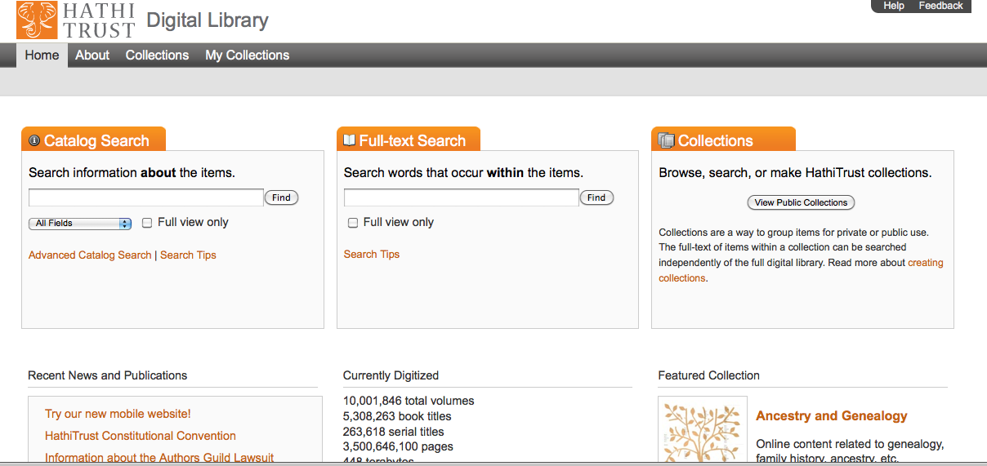
Large-scale digitization of information resources leads to exceptional opportunities
Europeana
Hathi Trust
http://www.europeana.eu/portal/
http://www.hathitrust.org/

Slide 25
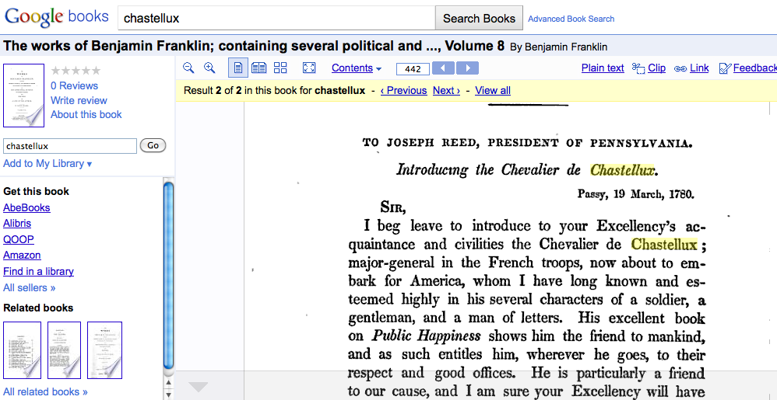
Google Books
Partner libraries include Harvard, Stanford, U. Michigan, Oxford, and many more
3 categories – copyright status
Personalized and social features
  Place names and maps
  Tracking passages
  Personal, shareable collections

Slide 26
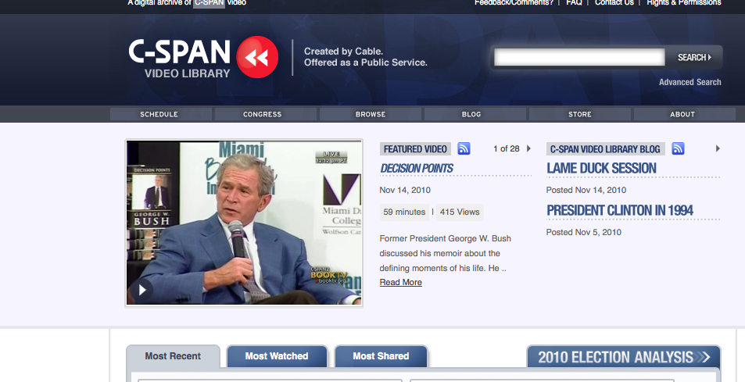
News video collections
http://www.c-spanvideo.org/videoLibrary/

Slide 27
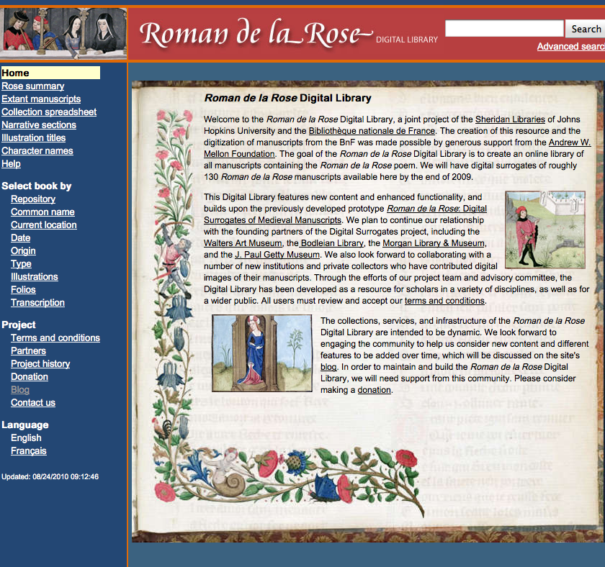
Manuscripts from different locations
http://romandelarose.org/#home

Slide 28
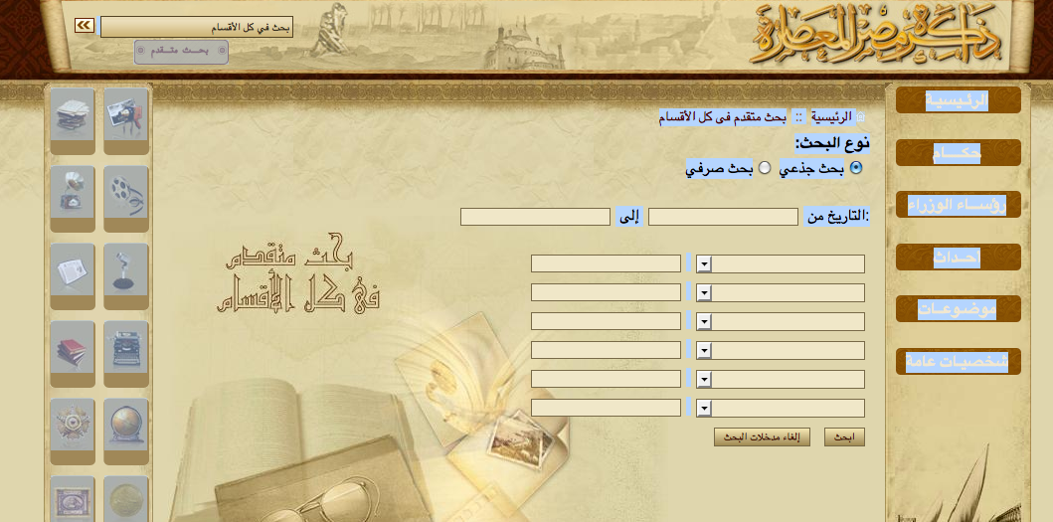
Foreign language resources
Search boxes for Memory of Modern Egypt Collection
http://modernegypt.bibalex.org/collections/global/advancedsearch.aspx

Slide 29
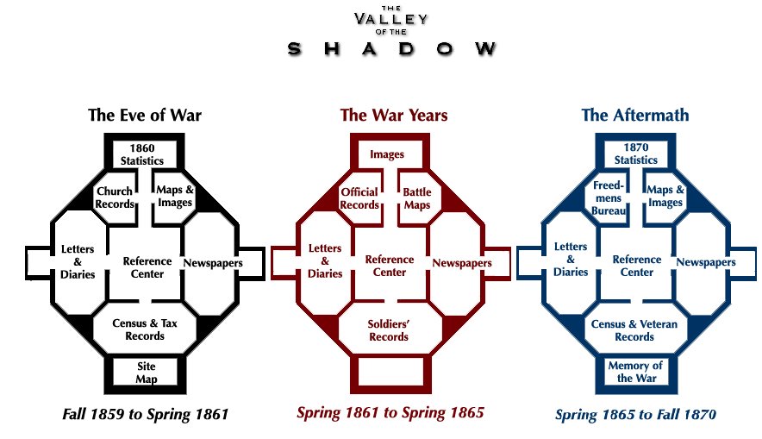
Rich primary sources on the US Civil War
http://valley.lib.virginia.edu/

Slide 30
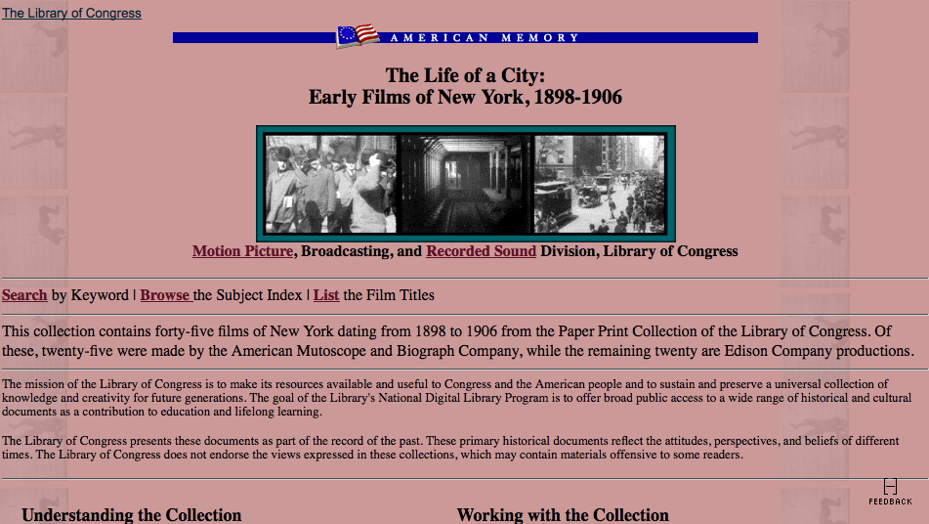
Multi-media primary sources
http://memory.loc.gov/ammem/papr/nychome.html

Slide 31
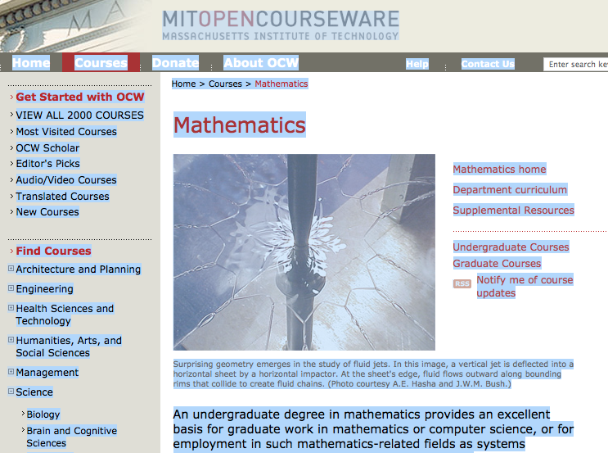
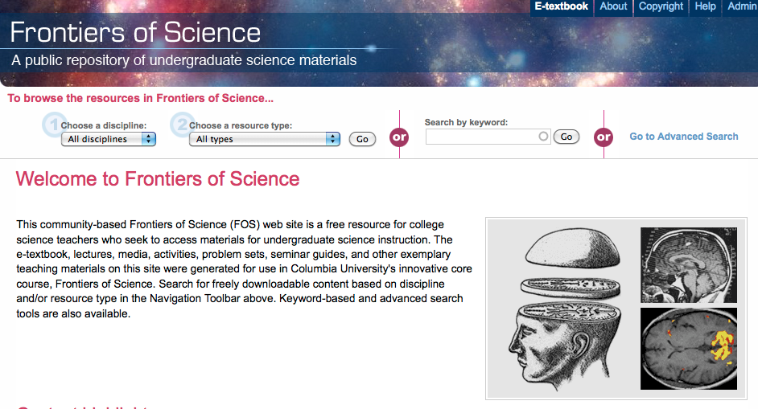
Do your students know about these? Should they?
MIT Open Courseware
http://ocw.mit.edu/index.htm
Columbia U.
http://frontiersofsci.org/

Slide 32
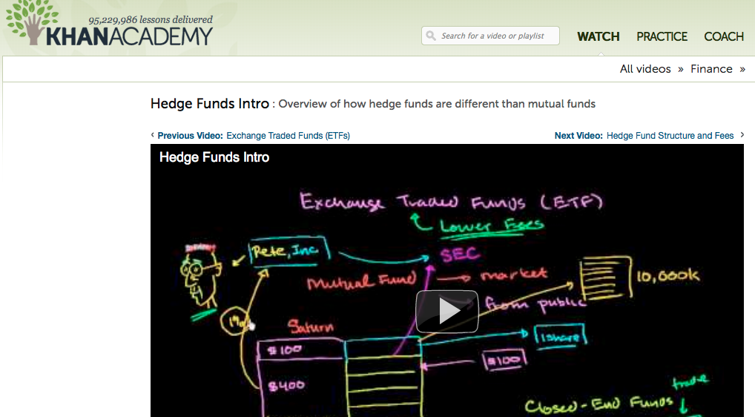
Khan Academy http://www.khanacademy.org/
“I use Khan Academy all of the time on YouTube…it gives you the material from a different perspective but it ties it all in with your class. If you don’t do outside work like this you end up with a C in some class. The classes just lay out the basic(s)…and the rest is up to you in college.” From Head & Eisenberg, PIL, 2011
http://projectinfolit.org/

Slide 33
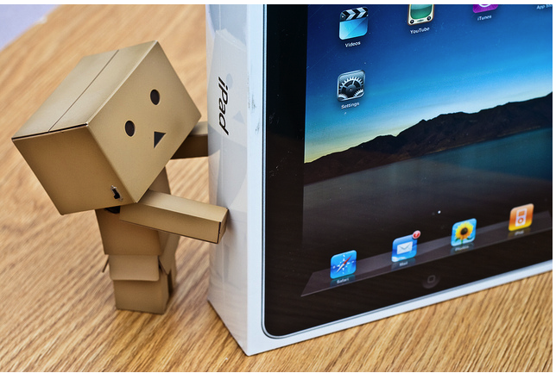
How would these new technologies or tools work for you?
http://www.flickr.com/photos/juehuayin/4556617846/

Slide 34
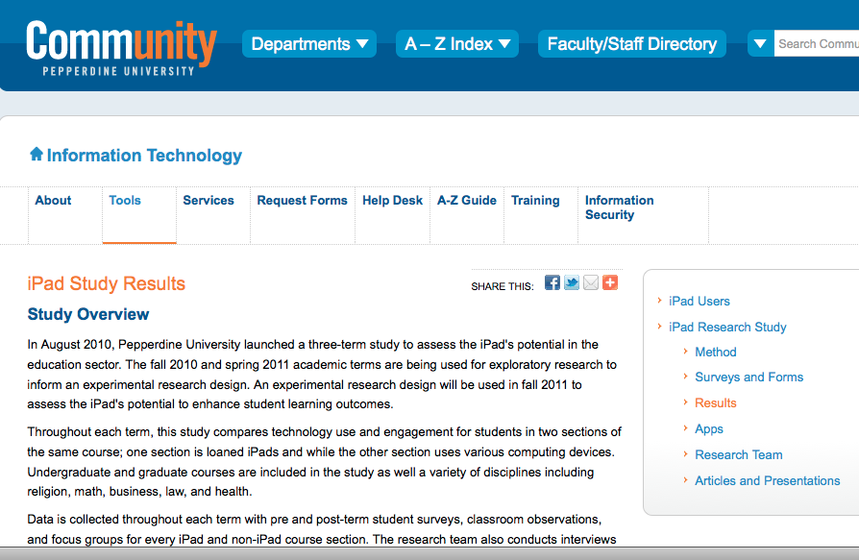
Incorporating mobile devices
http://community.pepperdine.edu/it/tools/ipad/research/

Slide 35
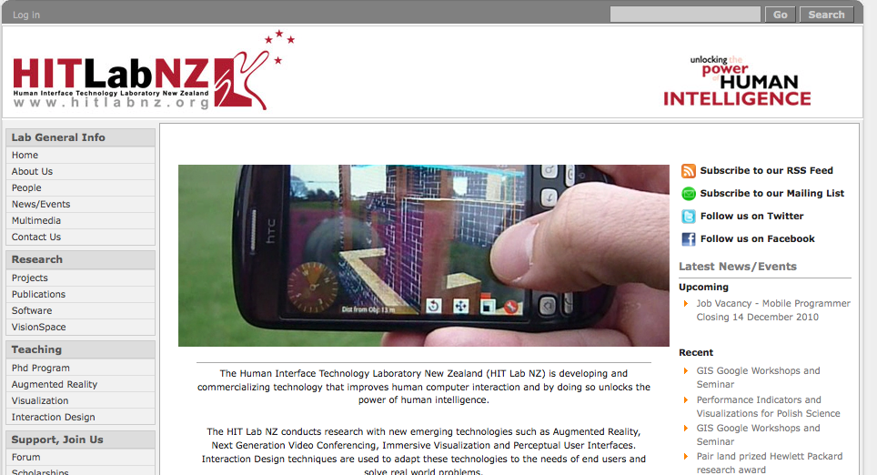
Augmented reality
http://www.hitlabnz.org/Home
Use an app to “see” how pieces of furniture would look in your apartment.
Field applications in business, geology, museums, city tours, etc.

Slide 36
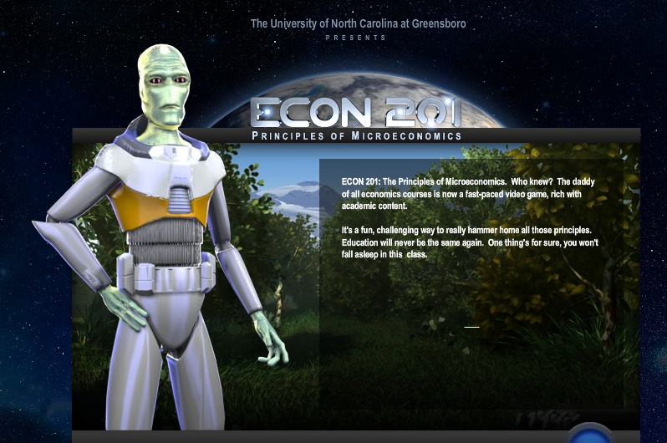
Online course in game format for microeconomics
http://web.uncg.edu/dcl/econ201/

Slide 37
Extending the dialogue
How would increased access to digital content enrich teaching and learning in your courses?
What are your preferences and your students’ preferences for format in what situations?
How would like to learn about new technologies and information resources?
How can campus partners support students to facilitate their use of information and technologies to create digital content in a way that promotes their understanding of academic discourse?

Slide 38
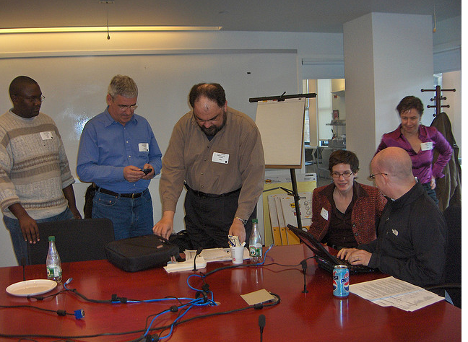
How can we make the most of these opportunities in the digital world?
It takes collaboration
Articulate what you want to do and what resources you need to do it
Find partners
Experiment
http://www.flickr.com/photos/edyson/115078906/

Slide 39
Resources
How People Learn. National Academy Press. http://www.nap.edu/openbook.php?isbn=0309070368
National Survey of Student Engagement (NSSE) http://nsse.iub.edu/

Slide 40
Thank you!
Joan K. Lippincott
joan@cni.org
http://www.cni.org/staff/joan_index.html
www.cni.org
Note: All photos from Flickr have Creative Commons licenses

