Slide 1
Responsiveness and Reflexivity in Everyday Pedagogy
FOTL January 14, 2021
Joerg Zimmermann, Ph.D.
Abha Rai, Ph.D., M.S.W.
D. Castro, Ph.D Candidate, M.Ed

Slide 2
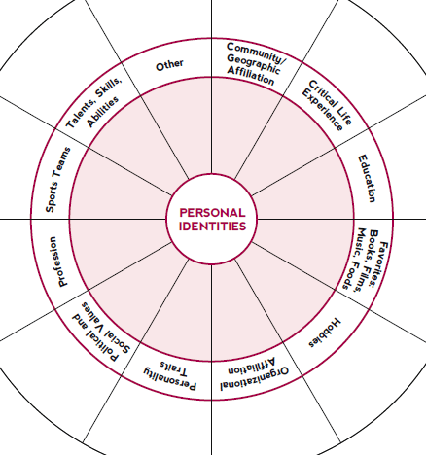
sites.northwestern.edu/msaatnu/2020/07/09/the-i-in-identity-series-identity-wheel-self-reflection/

Slide 3
Creating
Classroom
Cultures
with Castro

Slide 4
Looking in & building out
Before creating and establishing classroom norms reflect:
What kinds of things to I need in the learning environment to be an educator and learner?
What am I willing to do to for my students to build an environment that sees them as developing scholars and members of a community?
Notes:
(1 of 2)

Slide 5
Looking in & building out
Build opportunities for personal relationships to develop
Allow students to opt out of ice breakers
Hold 1-to-1 relational meetings
Music
Personality surveys
Think-Pair-Share
Embrace the tension that comes from decentralizing our power-over

Slide 6
Flexibility in facilitation
Evaluate class format often
Anonymously
Implement feedback as soon as possible

Slide 7
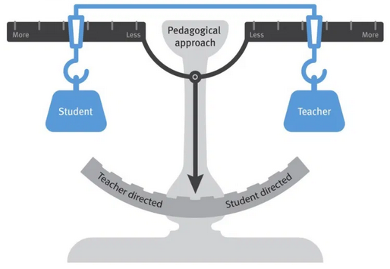
Feminist Teaching Pedagogy with Abha
Minimizing power imbalance in the classroom and devaluing hierarchy
Classroom as a shared and safe space
Everyone is a teacher and a student in the classroom!

Slide 8
Classroom community
Classroom style & Syllabus
Continued engagement outside the classroom
By the students, For the students and Of the students
Assignments
Formative assessment
In-class discussions

Slide 9
Classroom community
Classroom style & Syllabus
Beginning the semester by reflecting on our own positionalities and impact on implicit bias
Setting class norms at the beginning
Beginning class with one-word check-in’s to set the tone of the class
Adding voices of color to the syllabus to diversify the syllabus
Assignments
Students could submit a diverse range of assignments – podcasts, papers, Twitter/Instagram posts etc.
Suggest new content for the class through asynchronous discussions
Student self-assessment of class performance

Slide 10
Begin in-class discussions with ice-breakers to engage all students In-class journaling and prompts
Classroom community
In-class Discussions
Formative Assessment
Student questionnaire at the beginning
Ongoing student assessments about the content and teaching style

Slide 11
Strategies on building an inclusive classroom community
Continued Engagement Outside the Classroom
Non-office hours
Suggest topics for in-class discussion that may not come up during in-class discussion

Slide 12
Cultural Validation
College students, especially from non-traditional backgrounds, “need progressive and sustained assistance to ensure they stay enrolled and graduate from college”
L. Rendon (2002) “Community College Puente: A Validating Model of Education.” Educational Policy, 16, 4, 642-667

Slide 13
“Traditional” Students
“Non-Traditional” Students
white, middle- or upper-class students, not first in their family to attend college
coming to the university with social and cultural capital
college is an expected rite of passage
attended well sourced high schools and well educated teachers
people in their lives see them as smart and on their way to being the next generation of leaders
low income, working class, first in their family to attend college, students of color
may have doubts about their ability to do well in college
have been exposed to, or even pressured to consider more “realistic” educational and occupational choices
attended low resourced high schools
parents, while possibly emotionally supportive, may not be able to help students navigate the university or take full advantage of college

Slide 14
Validation in Praxis
institutional agents, not students, are expected to take the first step to not only promote involvement but to affirm students as knowers and valuable members of the college community
L. Rendon (2002) “Community College Puente: A Validating Model of Education.” Educational Policy, 16, 4, 642-667

Slide 15
Validation in Praxis
encourage: provide positive feedback, stress academic strength
individualize interactions and feedback and keep notes
actively connect students to campus services
affirm the value of student voice and experience
use instant polling instead of calling on students (Sakai, TopHat, Poll Everywhere, iClicker)
schedule communication e.g. by students submitting unanswered questions at the end of each class or a free-write activity at the beginning of class

Slide 16
Activities to Address and Recognize Student Identity
“This could be me” – students search for and create profiles of faculty that share one or more aspects of their identity
“Potato and Patata” - students share scientific terms in their native languages
“I AM FROM” – students reflect on their identity by completing a poem template
“Digital Testimonio” – students record videos about their out-of-school life

Slide 17
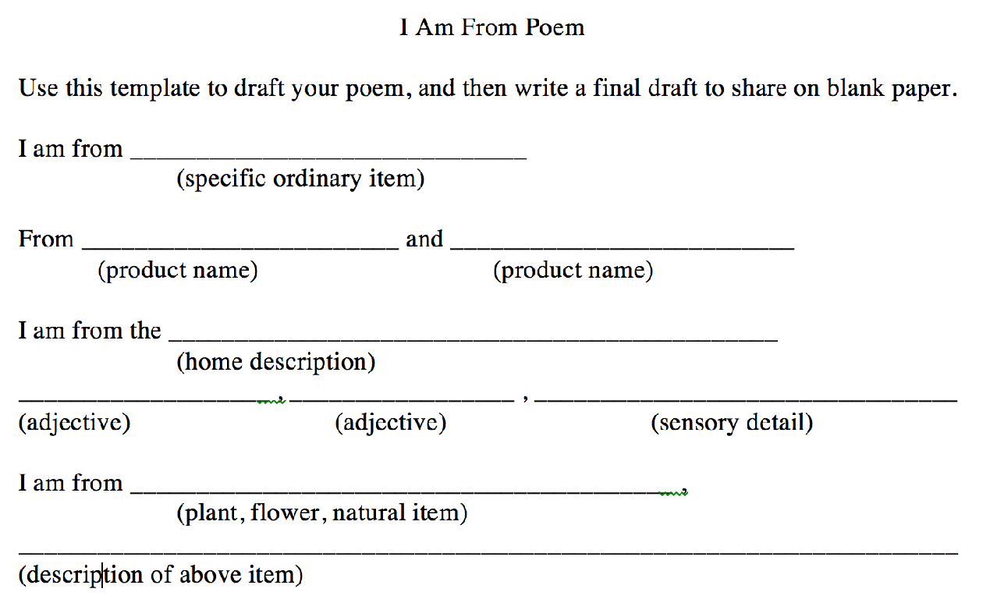
Inspired by “Where I’m From”
by George Ella Lyon
Marissa Vasquez, Asst. Professor, Cal State San Marcos

Slide 18
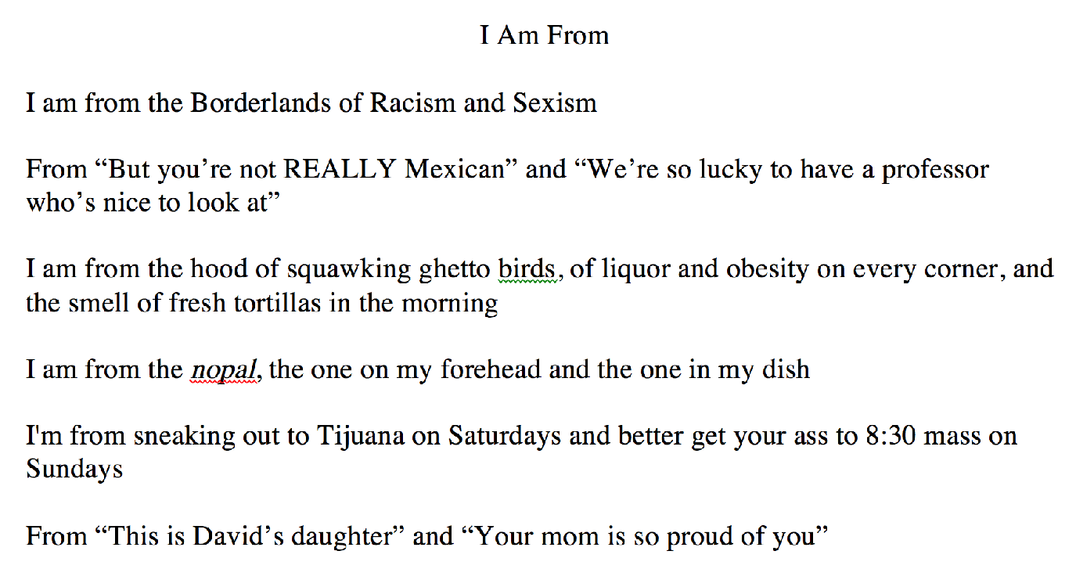
Marissa Vasquez, Asst. Professor, Cal State San Marcos

Slide 19
When validation is present, students feel capable of learning and have a sense of self worth
Students will think:
“I matter.”
“Somebody cares about me.”
“I am a capable person.

